Slide 1


SUPPLY CHAIN MANAGEMENT

Slide 2

Project Overview
In this project, we have used different types of analytical tools like Excel, Tableau, Power BI, SQL.
We have created different Dashboards.
This Data contains Sales and Inventory data from different states in USA by over year 2019 to 2023.
Also, We have described various types of Key Performance Indicators (KPI’s).

Slide 3
Introduction :
Supply chain management (SCM) is the discipline that manages the flow of supplies through all of the stages of a production cycle.
It involves the oversight and management of the flow of goods, information and finances as they move from supplier to manufacture to wholesaler to retailer to consumer.
Efficient SCM ensures timely delivery of products, reduces costs, and improves customer satisfaction.
Objective:-
By using Analytical tools and techniques, Supply Chain Management aims to analyze and Visualization to improve the flow of goods, services to Increase sales and Profit.

Slide 4
KPI 1 : Monthly Sales Trend
Highest Sales Month: March tops the chart with 38M in sales, indicating a strong performance during that month.
Lowest Sales Month: December sees the lowest sales at 26M, showing a decline towards the year's end.
Sales Fluctuations: Noticeable ups and downs throughout the year, with peaks in March (38M) and October (33M), and dips in July (29M) and December (26M).
Consistent Sales Periods: Several months, like April, May, June, August, and November, maintain sales around the 31M mark, showcasing a period of stability.
End-of-Year Decline: Sales drop from 33M in October to 26M in December, suggesting a seasonal downturn or market change.

Slide 5
KPI 2 : Region Wise Sales
East Region Dominance: With 108M in sales, the West region significantly outperforms others. This suggests a high demand that requires a robust supply chain to ensure consistent and timely deliveries. Prioritizing inventory management and distribution in this region is crucial.
Balanced Distribution Needs: The East (68M) and South (88M) regions also show substantial sales, indicating the need for a balanced and efficient supply chain across multiple high-performing regions. Ensuring an even allocation of resources to prevent stockouts or overstocks is key.
Opportunity in the Southwest and Midwest: Despite lower sales figures in the Midwest (59M) and Southwest (50M), these regions still contribute significantly. This could be an opportunity to explore potential growth by enhancing supply chain efficiency, improving customer service, and targeted marketing strategies.
Resource Allocation: Allocating resources effectively based on regional sales data can help in optimizing transportation routes, reducing costs, and improving overall supply chain performance. Focus on high-demand regions while ensuring smaller regions are not neglected.
Flexibility and Resilience: The varying sales figures highlight the importance of a flexible and resilient supply chain capable of adapting to regional demands and potential disruptions. Building strong local supplier relationships and diversifying supply sources can enhance resilience.

Slide 6
KPI 3 : Top 5 Store Wise Sales
Top Performers Focus: Argyle Store #326 and Clarges Store #942, each with 5M in sales, suggest that supply chains supporting these stores are efficient. Analyzing the strategies behind their performance can offer insights for other stores.
Mid-Range Performance: King Store #922 and Tilloch Store #799, both at 4M, indicate moderate performance. There's room to optimize their supply chain processes to boost sales and reach the top performers' level.
Low Performer Improvement: Hammersmith Store #557, with 3M in sales, may benefit from a closer look at its supply chain. Identifying bottlenecks and inefficiencies could help elevate its performance.
Sales Distribution Gap: The noticeable sales gap between the lowest and highest performers highlights potential areas for improvement. Streamlining supply chain operations across all stores could help close this gap and enhance overall efficiency.

Slide 7
KPI 4 : Top 10 State Wise Sales
California leads by a large margin with sales at 88M, more than three times that of the second highest states, Florida and Texas, both at 27M.
After Florida and Texas, there's a notable decline, with Michigan trailing at 16M, 11M less than the second highest states.
The combined sales of the bottom eight states (Michigan to New Jersey) total 110M, which is only slightly more than California's sales alone, emphasizing California's leading position

Slide 8
KPI 5 : Inventory Value
Inventory value is used to understand the financial impact of inventory on the business.
This aids in budgeting and financial planning.

Slide 9
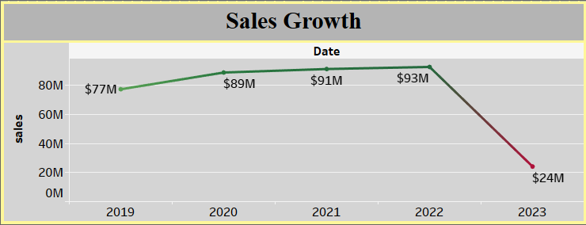
KPI 6 : Sales Growth
Sales climbed consistently from 2019 to 2022, reaching a peak of $93M in 2022, indicating
Strong market performance and potential consumer demand during this period.
In 2023, sales experienced a dramatic drop to $24M. This sharp decline raise questions about market conditions, competitive pressures, or internal challenges that might have impacted
performance

Slide 10
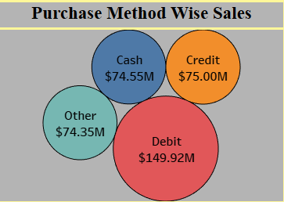
KPI 7 : Purchase Method Wise Sales
Dominance of Debit Sales: Debit sales dominate with a total of $149.92M, indicating a strong customer preference for using debit cards. This suggests a need for ensuring smooth processing and handling of debit transactions to maintain customer satisfaction.
Close Competition Between Credit and Cash: Sales for credit ($75M) and cash ($74.55M) are almost neck and neck. This balance highlights the importance of optimizing both payment methods to cater to diverse customer preferences effectively.
Significant Role of Other Methods: The "Other" category accounts for $74.35M in sales, not far behind credit and cash. This suggests that alternative payment methods, perhaps mobile payments or digital wallets, are also key players in the sales mix.
Balanced Distribution Among Non-Debit Methods: The sales figures for credit, cash, and other methods are relatively even, each contributing around $74M to $75M. This balance indicates a diverse range of preferred payment methods among customers, necessitating a flexible and adaptable payment processing system.

Slide 11
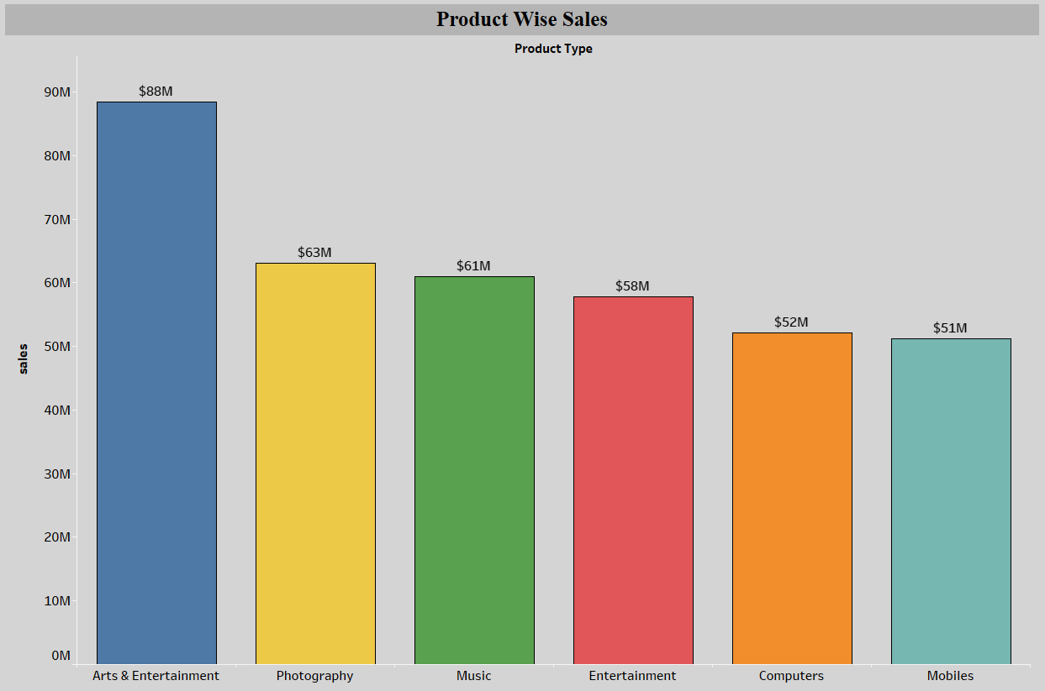
KPI 8 : Product Wise Sales
High Sales in Arts & Entertainment: With $88M, Arts & Entertainment stands out as the top-selling category. Prioritizing inventory management, supplier relationships, and logistics for this category is crucial to sustaining its high performance.
Moderate Sales in Photography and Music: Photography and Music have closely matched sales figures at $63M and $61M, respectively. Streamlining the supply chain to ensure optimal stock levels and efficient distribution for these products can help maintain their performance and possibly boost sales further.
Varied Sales Across Categories: There’s a significant drop from Arts & Entertainment to Photography, followed by a gradual decline through Entertainment ($58M), Computers ($52M), and Mobiles ($51M). This indicates a need for differentiated supply chain strategies tailored to each product category to manage varying demand levels.
Focus on Lower Performing Categories: Mobiles, with the lowest sales at $51M, might benefit from an improved supply chain strategy. This could involve better forecasting, reducing lead times, and enhancing distribution efficiency to meet market demand more effectively.

Slide 12
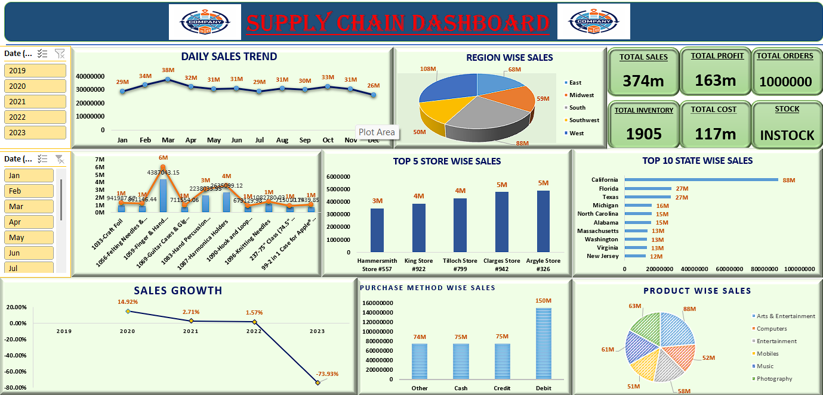

Slide 13
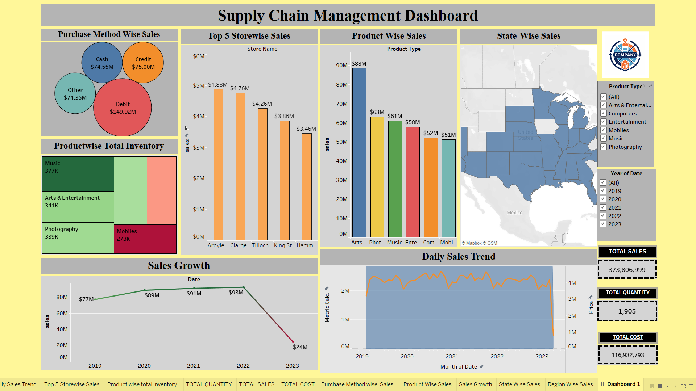

Slide 14
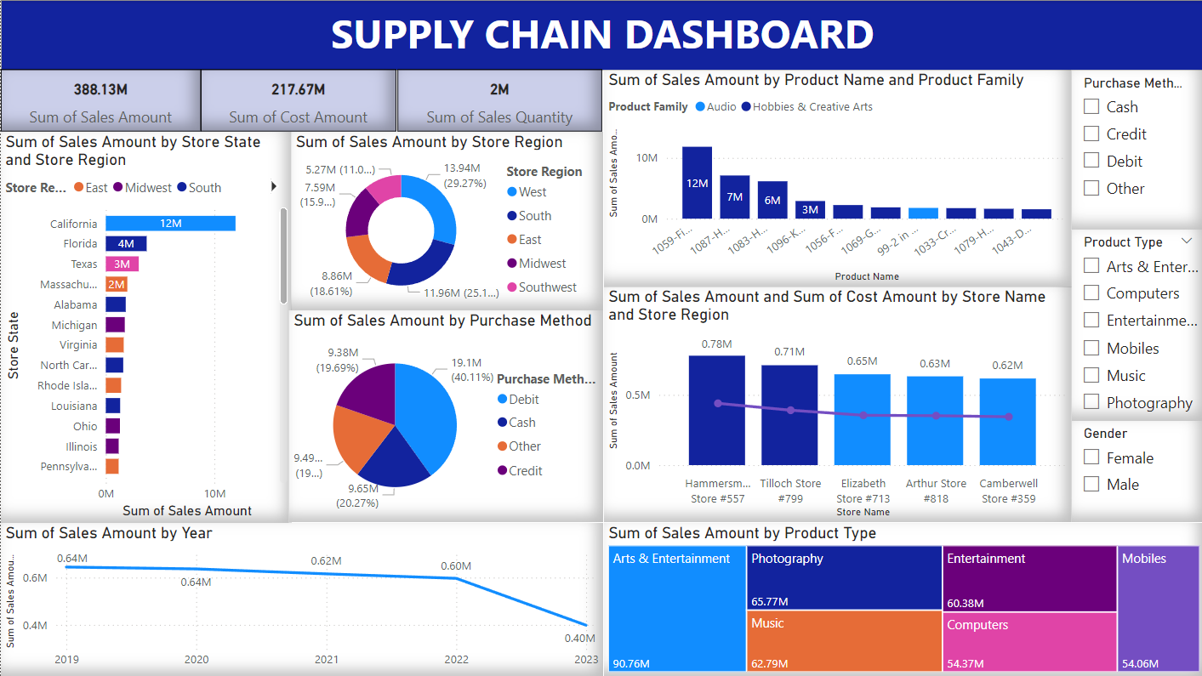

Slide 15
Thank You

